Slide 1

IoT Session 10
Dr Faisal Iradat

Slide 2
Topics
Real Time Operating System (RTOS)?
Mongoose OS
AWS SNS Push Notifications
AWS S3 and Data Objects
AWS DynamoDB

Slide 3
What is a Real Time Operating System (RTOS)?
A Real Time Operating System
Commonly known as an RTOS
is a software component that rapidly switches between tasks, giving the impression that multiple programs are being executed at the same time on a single processing core.
In actual fact the processing core can only execute one program at any one time, and what the RTOS is actually doing is rapidly switching between individual programming threads (or Tasks) to give the impression that multiple programs are executing simultaneously.

Slide 4
OS or RTOS
Difference
OS (Operating System) such as Windows or Unix
RTOS (Real Time Operating System) found in embedded systems
Response time to external events
OS’s typically provide a non-deterministic, soft real time response, where there are no guarantees as to when each task will complete, but they will try to stay responsive to the user
An RTOS differs in that it typically provides a hard real time response, providing a fast, highly deterministic reaction to external events.
Comparison
Editing of a document on a PC
Operation of a precision motor control.

Slide 5
Scheduling Algorithms
When switching between Tasks the RTOS has to choose the most appropriate task to load next.
There are several scheduling algorithms available, including Round Robin, Co-operative and Hybrid scheduling.
However, to provide a responsive system most RTOS’s use a pre-emptive scheduling algorithm.

Slide 6
Tasks and Priorities
In a pre-emptive system each Task is given an individual priority value.
The faster the required response, the higher the priority level assigned.
When working in pre-emptive mode, the task chosen to execute is the highest priority task that is able to execute. This results in a highly responsive system.

Slide 7
What is IoT OS ?
Designed to perform within the constraints that are particular to Internet of Things devices, including restrictions on memory, size, power and processing capacity.
An Embedded Operating system but by definition are designed to enable data transfer over the internet.
IoT OSes control systems in cars, traffic and streets lights, Smart TVs, ATMs, airplane controls, point of sale (POS) terminals, digital cameras GPS navigation systems, elevators, digital media receivers and smart meters among many other possibilities.
IoT OS are an evolution of embedded OS, IoT brings its own additional set of constraints that need to be addressed. A mix of open source and closed source / commercial IoT OS exist today.

Slide 8
What are the parameters for selecting a suitable IoT OS?
Footprint: Since devices are constraint, we expect OS to have low memory, power and processing requirements. The overhead due to the OS should be minimal.
Portability: OS isolates applications from the specifics of the hardware. Usually, OS is ported to different hardware platforms and interfaces to the board support package (BSP) in a standard way, such as using POSIX calls.
Modularity: OS has a kernel core that’s mandatory. All other functionality can be included as add-ons if so required by the application.
Connectivity: OS supports different connectivity protocols, such as Ethernet, Wi-Fi, BLE, IEEE 802.15.4, and more.
Scalability: OS must be scalable for any type of device. This means developers and integrators need to be familiar with only one OS for both nodes and gateways.
Reliability: This is essential for mission-critical systems. Often devices are at remote locations and have to work for years without failure. Reliability also implies OS should fulfil certifications for certain applications.
Security: OS has add-ons that bring security to the device by way of secure boot, SSL support, components and drivers for encryption.

Slide 9
Open Source vs Commercial IoT OS
TinyOS, RIOT, Contiki, Mantis OS, Nano RK, LiteOS, FreeRTOS, Apache Mynewt, Zephyr OS, Ubuntu Core 16 (Snappy), ARM mbed, Yocto, Raspbian, Mongoose OS are some Popular open Source OS.
Android Things, Windows 10 IoT, WindRiver VxWorks, Micrium µC/OS, Micro Digital SMX RTOS, MicroEJ OS, Express Logic ThreadX, TI RTOS, Freescale MQX, Mentor Graphics Nucleus RTOS, Green Hills Integrity, Particle.

Slide 10
Mongoose OS
What is Mongoose OS?
Mongoose OS is an Internet of Things Firmware Development Framework available under Apache License Version 2.0.
Supports low power, connected microcontrollers such as: ESP32, ESP8266, TI CC3200, STM32. Its purpose is to be a complete environment for prototyping, development and managing connected devices.
Features
MCU support – STMicro: STM32 F4, L4, F7 | TI: CC3200, CC3220 | Espressif: ESP32, ESP8266
Advanced features – Reliable Over-The-Air update | Secure device provisioning | Remote management
Cloud integrations – AWS IoT, Google IoT | Microsoft Azure, IBM Watson | Private MQTT / REST backends

Slide 11
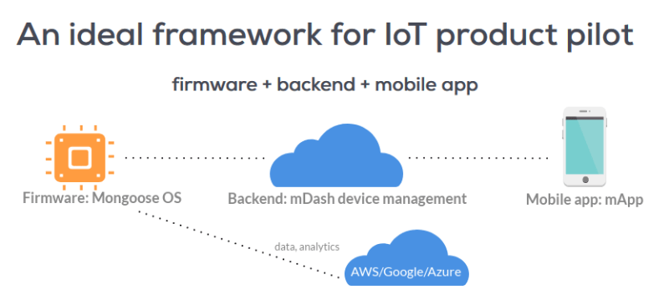

Slide 12
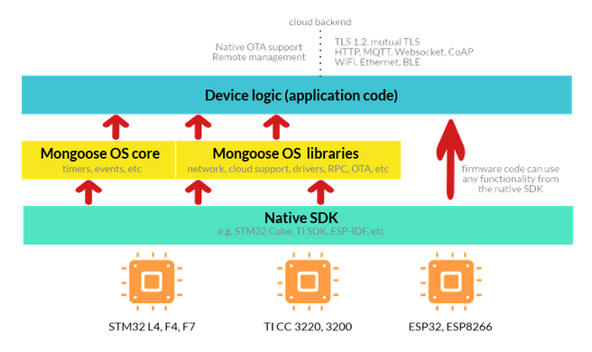

Slide 13
mDash and Mobile app
mDash is an IoT device management.
mdash provides many features
Update Reliable, fail-safe OTA firmware updates, Web UI Online/offline device status and metadata (firmware version, build time, etc), Device twin Device twin / shadow support, compatible with AWS IoT and Azure IoT.
Mobile app is Available instantly for iOS, Android, Web. Notification and control Devices.

Slide 14
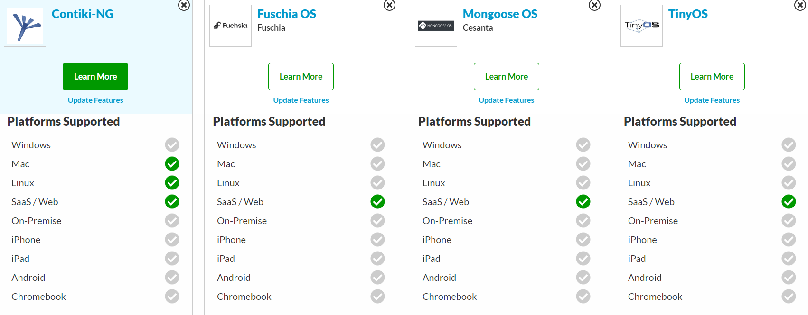
https://sourceforge.net/software/compare/Contiki-NG-vs-Fuschia-OS-vs-Mongoose-OS-vs-TinyOS/

Slide 15
Activity
How to install Mongoose OS
Send SNS Push Notifications
Storing data objects in AWS S3
Storing data in AWS DynamoDB

Slide 16
Mini Project

